Slide 1
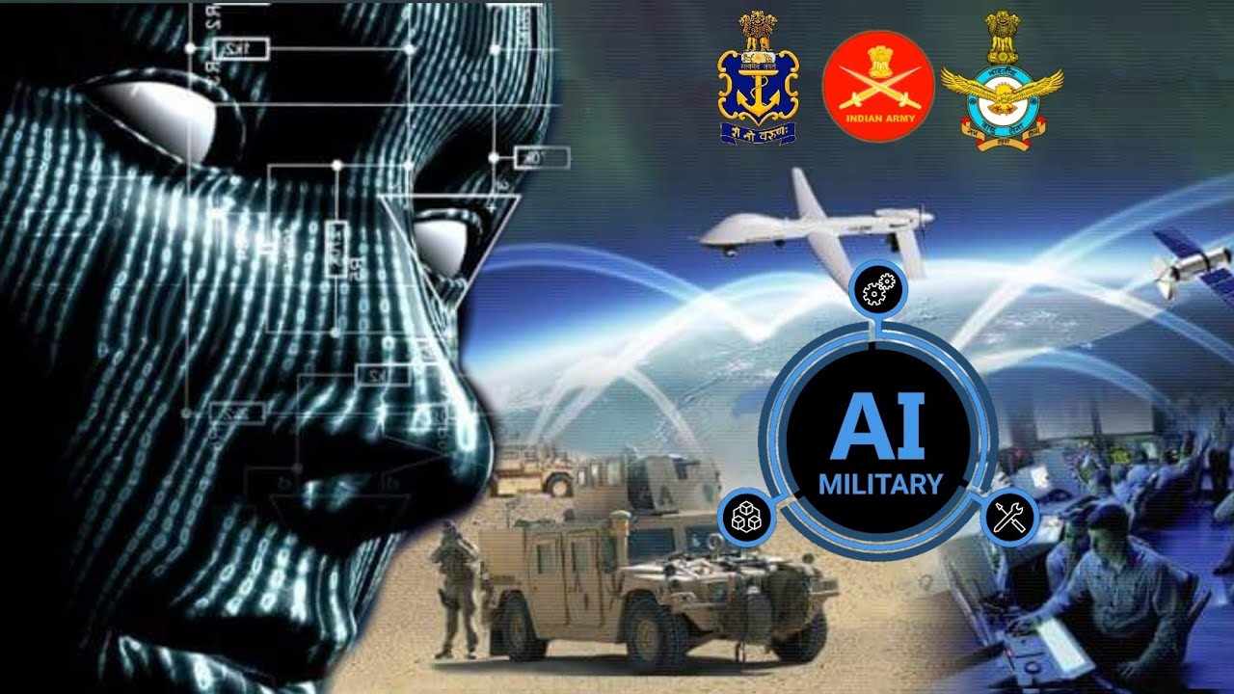
Avatar robots in border security using 5G technology
Presentation Team :
Rashmi Vernekar
Pushpavati D myageri
Yusuf
Ijaz H
L2 Faculty: Mohammad Tahir Mirji

Slide 2
Agenda
Problems in border security
Introduction of 5G in military
How 5G could help in powering telecommunications in india
Proposed Solution
Step 1 - Designing remote controlled robot with 5G
Step 2 - Command Center Remote Operation Sensors Jacket
Impact of technology implemented with military robot
Socio-Economic Impact with respect to human life and comparison with robots

Slide 3
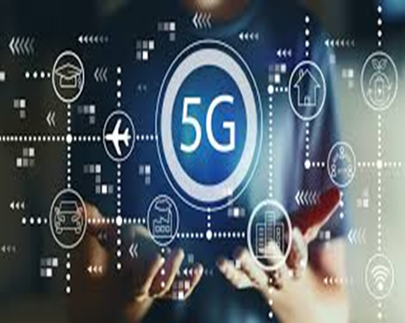
Introduction to 5g technology

Slide 4
Problems in border security
Sections of the boundaries are unsettle.
Terrains are diverse and difficult.
Border areas are underdeveloped.
Connectivity with the hinterland and across to other countries is poor.
Border populations feel insecure.
Borders areas in remote parts are getting depopulated.
Illegal migrations, which alter demographic ratios, present a major challenge.

Slide 5
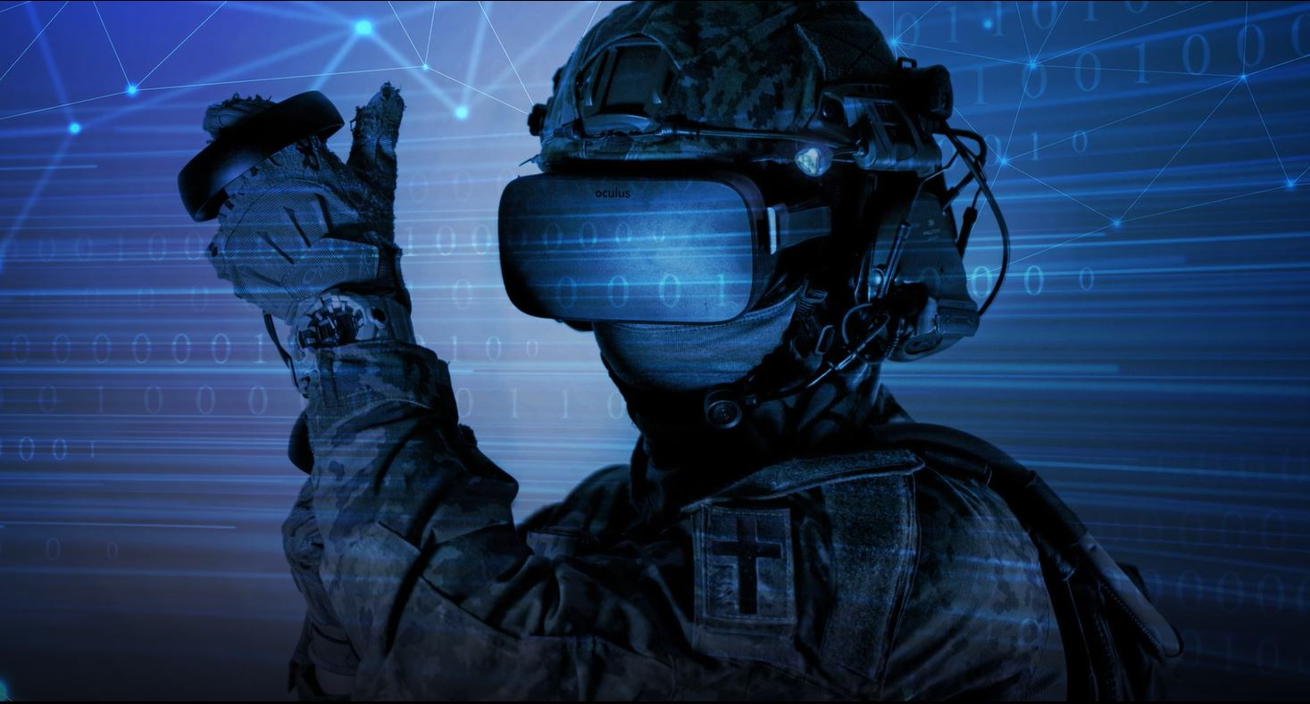
Introduction of 5G in military
Secure wireless data communication is hugely important for the military, both at home and abroad.
Besides the apparent administrative use, this goes not least the military tactical communication management system.
5G allow access to data from video, voice, sensors, targeting and even the sights on infantry weapons are easy and instantaneous for anyone who needs it.

Slide 6
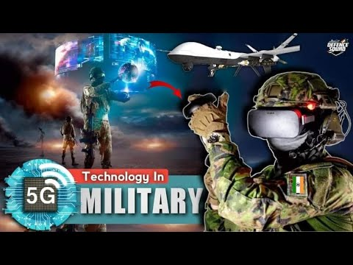
How 5G could help in powering telecommunications in India
5G’s speed is of 20 gigabits per second it will help below areas to work:
5G FOR HYPERSONIC WEAPONS
5G FOR THE ‘SMART’ MILITARY BASE
5G FOR THE ‘BATTLE NETWORK’
5G FOR ‘BATTLEFIELD WEARABLES’
5G FOR DRONES AND ARTIFICIAL INTELLIGENCE

Slide 7
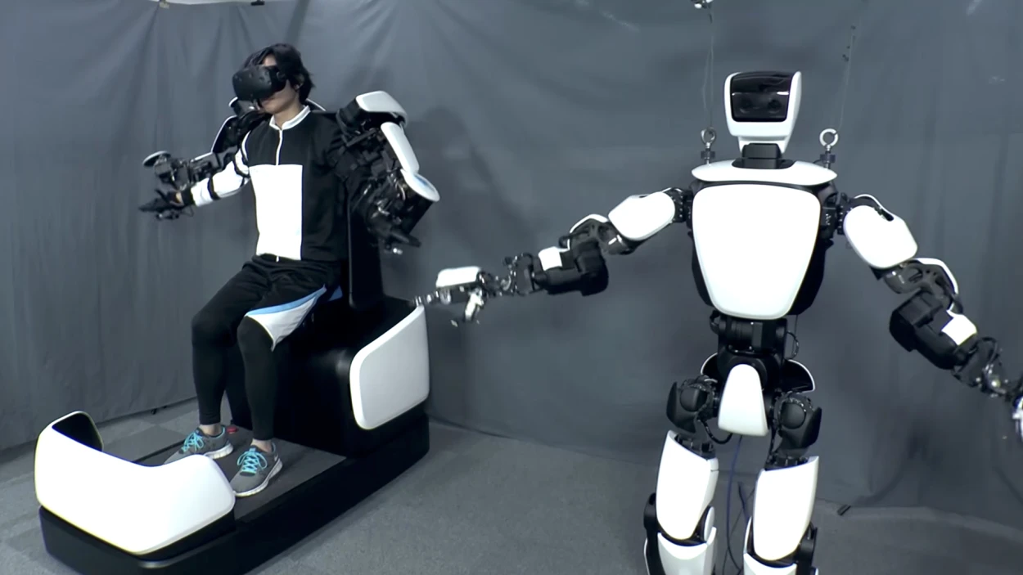
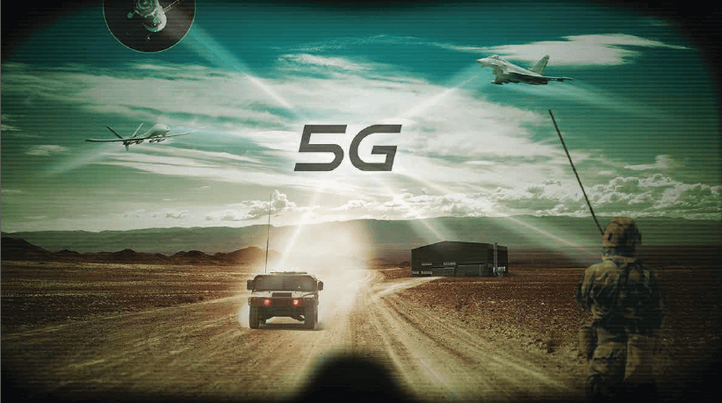
Proposed Solution
The robot dogs are manufactured by Ghost Robotics, a security tech company that works with the military.
The plan is for the machines to patrol the border, videoing and scanning around them as they go.
This has led to privacy concerns about the surveillance of those who live near the border without consent.

Slide 8
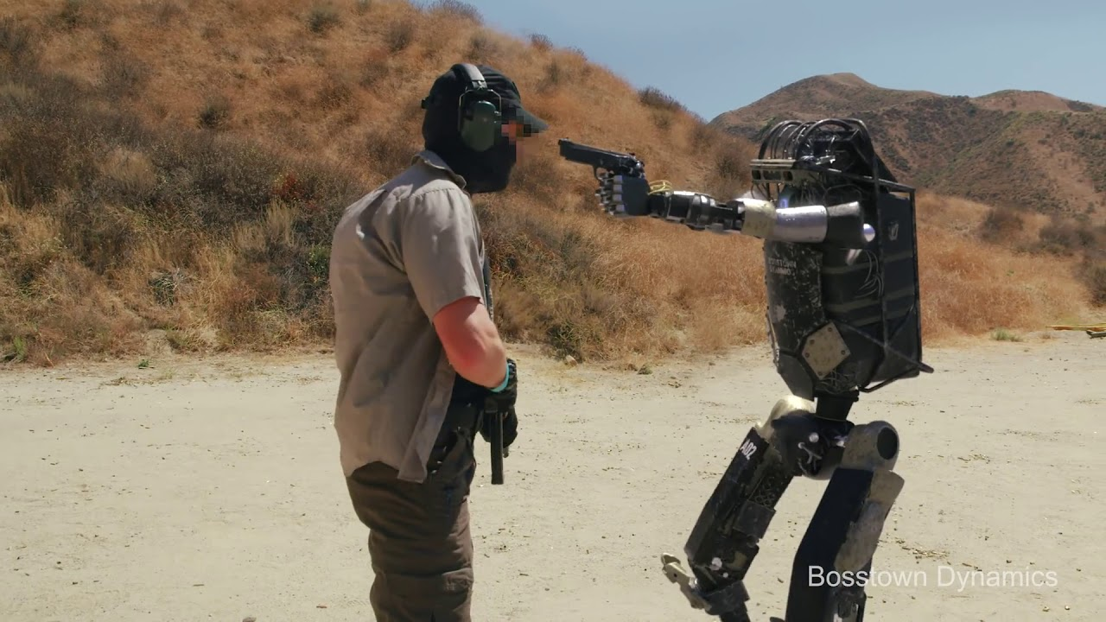
Step 1 - Designing remote controlled robot with 5G
Robots with 5G connected interaction from command center will help save humans in field by being one of line of defence.

Slide 9
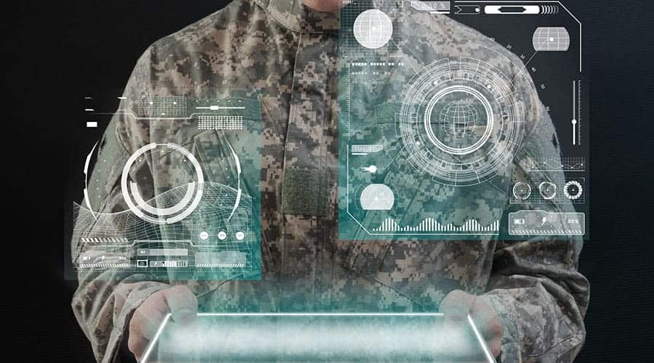
Step 2 - Command Center Remote Operation Sensors Jacket
Remote control the robot on borders from command center to eliminate enemy.

Slide 10
Impact of technology implemented with military robot
Robots eliminate dangerous jobs for humans because they are capable of working in hazardous environments.
They can handle lifting heavy loads, toxic substances and repetitive tasks in military borders surveillance.
Human lives can be saved if robots are sent into frontline combat.

Slide 11
Socio-Economic Impact with respect to human life and comparison with robots
Robotics can help improve multi-fold capabilities of the military and defense industry in the nearby tech-driven future.
Robotics can bring smiling faces to families of human soldiers for the reduced fear of losing lives in battlefields or neutralizing bombs.
The million-dollar investment in robotics can bring some advantage-gaining tactics and strategies to combat potential attacks of enemies.
The military and defense industry should be prepared for replacing conventional processes with advanced technologies to preserve the safety of soldiers as well as citizens.

Slide 12
Thank you for listening

